Slide 1
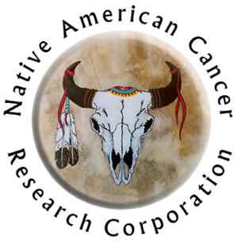


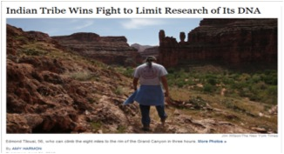
Native American Cancer Research (NACR) Corporation: “Genetic Research and Native American Ethical, Legal, Social and Cultural Issues” Fact Sheet designed to be used with the “Genetic Definitions and Explanations” Fact Sheet” for Public Health Professionals and Interested Community Members
Informed consent process includes you asking and receiving answers to questions about a study.
You need to understand the purpose of the study, how your privacy, the tribe’s confidentiality, and cultural issues will be respected and protected.
You need to understand what will happen with your specimen and if your tribal Nation has any issues with you taking part in a genetic study.
You need to make an informed decision about taking part in any study. It is your decision and no one should pressure you.
Now you know, now you can.
Your
Health
& IMPROVE YOUR QUALITY OF LIFE
What causes cancer?
Daily Behavior / Lifestyle (not enough physical activity, unhealthy food, excess alcohol, habitual use of tobacco) = cause changes in genes within body cells
Environment (exposure to contaminants, e.g., asbestos) = cause changes in genes within body cells
Heredity (chromosome from mother and father that created the fertilized egg that resulted in YOU) = only 5-10% of all cancers
Native People need to understand the genetic research in which they are considering taking part. Some tribes are uncomfortable with the lack of protection and respect for tribal specimens.
So how do those “cause” cancer?
When you are exposed to environmental contaminants or behave in unhealthy ways, these exposures and behaviors can result in damage to genes in your body.
Frank Dukepoo, PhD
Laguna Pueblo and Hopi
Passed 1999
Havasupai Tribal Nation
In 2010, the Havasupai Tribal Nation settled a class action lawsuit against Arizona State University and the University of Arizona based on misuse of blood samples and DNA originally collected for research on diabetes. It was learned that these research specimens were later used for multiple other purposes including research on “schizophrenia, inbreeding and population migration.” (Kiefer 2010 and Sehgal 2010).

Slide 2

Information about “Genes”
The pattern of information within genes needs to follow a specific sequence for the cell to function correctly.
When the sequence differs, it is called a “mutation” (or SNP, pronounced “snip”)
Most mutations or SNPs are acquired; You are not born with them.
Every body has mutations (or SNPs) causing:
  No effect on the function of the gene
  The gene to continue having the function
  The gene to do something different than what it was supposed to do
Example:
  Human bodies have a segment of a gene called “p53”
  p53 helps protect the body against cancer
  A change or damage in the segment of the gene that makes p53 can cause p53 to turn “off”. Then it no longer helps protect the body from developing cancer (or making more copies)
  More than half of all cancer tumors have damage in the area of the gene that makes up “p53”
Why is it important for providers to collect family history information?
Accurate family histories are needed to determine if a cancer risk is likely to be hereditary or from other causes (daily behaviors, exposure to environmental contamination)
Helps the genetic counselor work with the patient to decide whether or not the patient is genetically at high risk for a condition and should have a genetic test (most cancer genetic tests are expensive)
Helps the provider make a diagnosis
Clarifies daily behaviors versus inherited risks for people who are adopted
May reveal patterns of inheritance within the family
Clarifies family myths regarding who in the family is at risk
Helps explain why some members of the family are not affected
Sample Cancer Family History Questionnaire
Name
Date
Age
Ethnic Background
Do you have any specific concerns about cancer in yourself or your family?
Do you or any members of your family have a history of cancer?
First Degree Relatives | Yes / No | Types of Cancer (if known) | Age at Dx | Living / Deceased
Yourself
Your mother
Your father
Your sisters & brothers
Your children
What are examples of issues for which Native American organizations rarely consider a priority?
Patents resulting from genetic studies conducted with Native groups are frequently prohibited.
  This is primarily due to fears based on multiple historical events that the Native peoples will not have access to the new medications or discoveries (cost , lack of equipment).
Mitochondrial DNA Studies
  These are to study origins
  Most tribes are comfortable with their tribal stories of origin and are less interested in scientific interpretations of migration from the African continent

Slide 3

What are common factors / issues that affect Native American organizations collaboration with external research institutions?
The genetic research topic must be relevant and of interest to the local tribal, urban, or Native organization (e.g., diabetes, obesity, cancer treatment).
Most tribal nations, urban and Native organizations realize that building a relationship based on trust and respect allows for a free exchange of information when discussion genetic research/grants/projects or clinical studies
These relationships can take up to two or more years to develop
Tribal, Urban, Native Health Board approvals
  Each Native organization has an internal approval process that requires multiple meetings and communication. There are multiple levels of approval required. The process is likely to take 3 to 6 months.
Successful partnerships typically try to use community-based participatory research (CBPR) strategies throughout the study.
  True CBPR results in the Native group being an equal partner and decision-maker for all parts of the study
    Planning the project
    Sharing budget resources (equivalent amount for Native partner)
    Identifying research priorities from the tribal / urban / Native perspective
    Creating the research methodology to be respectful of local Native beliefs and practices
    Collecting and storing the data
    Analyzing the findings
    Writing reports
    Disseminating results to Native communities and professionals
Protections against potential discrimination: the research results must be reviewed with the Native partners to assure language is respectful and will not result in decreased access to services, medications, insurance and so on.
Some tribes have cultural issues regarding the types of specimens allowed.
  Most common are hair (with hair root) and blood.
  Blood samples are less often an issue for prenatal genetic tests than they are for adult genetic tests.
  Such concerns are not issues if the blood test is for individual diagnosis or medical care (i.e., specimen will not be stored or shared with others).
  Such concerns are rare to non-existent among Alaska Natives.
  Knowledge of adoption my cause more harm than other risks
Many Native groups are comfortable with an easy-to-understand informed consent process that is specific to a single study.
  This comfort partially is based on the:
    Specimens not being shared for studies other than the one identified in the informed consent.
    Disposal of the specimens after the study is completed. This may involved a special process (e.g., returning the specimens to local traditional healer for culturally acceptable ceremony).
    Specimens not being stored in a repository or biobank for use by other researchers (to create cell lines, use for studies other than the one addressed in consent process.
    Allowing the individual to discuss their participation with their family or health care provider (s) prior to signing
x
x
What
x

Slide 4
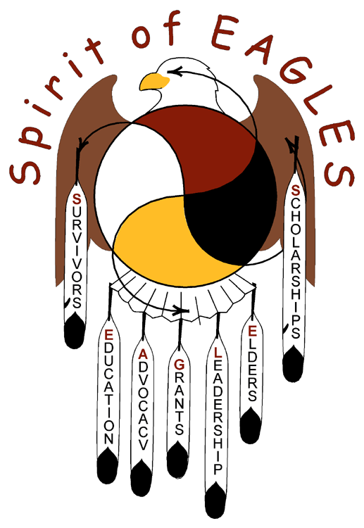

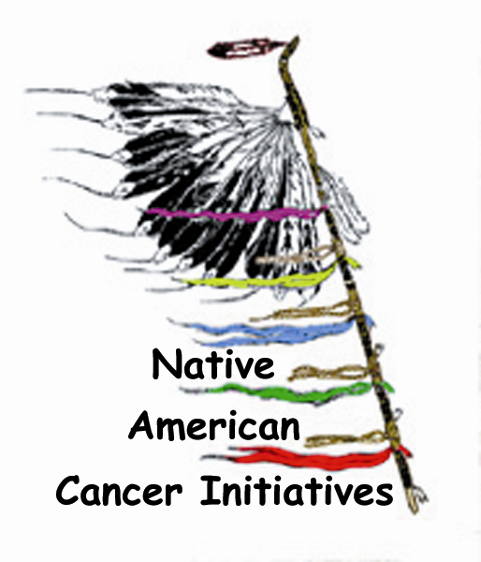
Using BRCA2 as an example
BRCA 2 scenario (cont.)
The counselor explains that it refers specifically to your parents (biological mother and father), siblings and children only, then asks, “what “explain what you know of cancer in your family” types of cancers has your family experienced?”
The granddaughter says, “breast, lung, head and neck, leukemia, thyroid; they’ve had it all. I heard you have a breast cancer test. I want it.”
The counselor responds, “Well, that is a lot of cancer, but those are not the types of cancer related to the hereditary type of breast cancer. Your family does seem to have increased risks of some type.
The granddaughter cries and says, “I want to have the breast test to make certain my child is not going to get cancer!”
The counselor explains that the test does not guarantee protection from breast cancer and that most patients with breast cancer do NOT have the hereditary form of breast cancer. Also, the test is expensive and IHS / Tribes / Urban Indian programs would not pay for the test because she does not have a first degree relative s with cancer and therefore is not at high risk for the genetic characteristic.
The counselor continues to listen to her talk about her fears and concerns of breast and other types of cancer. She takes a family history and discusses what the information means. She works with her on other behaviors to help protect her baby.
By the time the granddaughter leaves, she is relieved to know she is unlikely to carry a hereditary form of breast cancer.
BRCA2 (BR=breast; CA=cancer; 2=2nd mutation/ SNP identified) known to cause certain types of cancers:
  Women
    Breast
    Ovarian
Risks for other types of cancer may be higher than for people who do not have the mutation:
  Colon
  Pancreatic
  Stomach
BRCA2 tests cost >$1,000
  Men
    Breast
    Prostate
  Gallbladder
  Melanoma
BRCA 2 scenario
American Indian granddaughter is pregnant with her first child. She is concerned that her child is at risk for breast cancer.
The genetic counselor asks why she is concerned
The granddaughter says, “Cancer is all over my family. I do not want my child to get this disease.”
The counselor asks, “Which family members have been diagnosed with cancer?”
My auntie, my cousins, 2 uncles: it is all over my family!”
The genetic counselor asks, “Well, actually there is much less risk to you and your baby because the family members are aunts, uncles and cousins. We are more concerned when the relative is what is called a ‘first degree relative’. Do you know what that means?
The granddaughter says, “no”.
Fact Sheet & Info Partially Supported by:
Mayo Clinic’s “Spirit of EAGLES Community Network Programs 2” [P.I. Kaur; U54CA153605]
National Center for Minority Health & Health Disparities [PI: Burhansstipanov, R24MD002811]
Content excerpts from Native American Cancer Initiatives, Incorporated (NACI); used with permission by Linda Burhansstipanov and Lynne Bemis
For more information, contact
Native American Cancer Research Corporation (NACR)
3022 South Nova Road, Pine, CO 80470-7830, Phone: 303-838-9359 http://www.NatAmCancer.org

